Slide 1
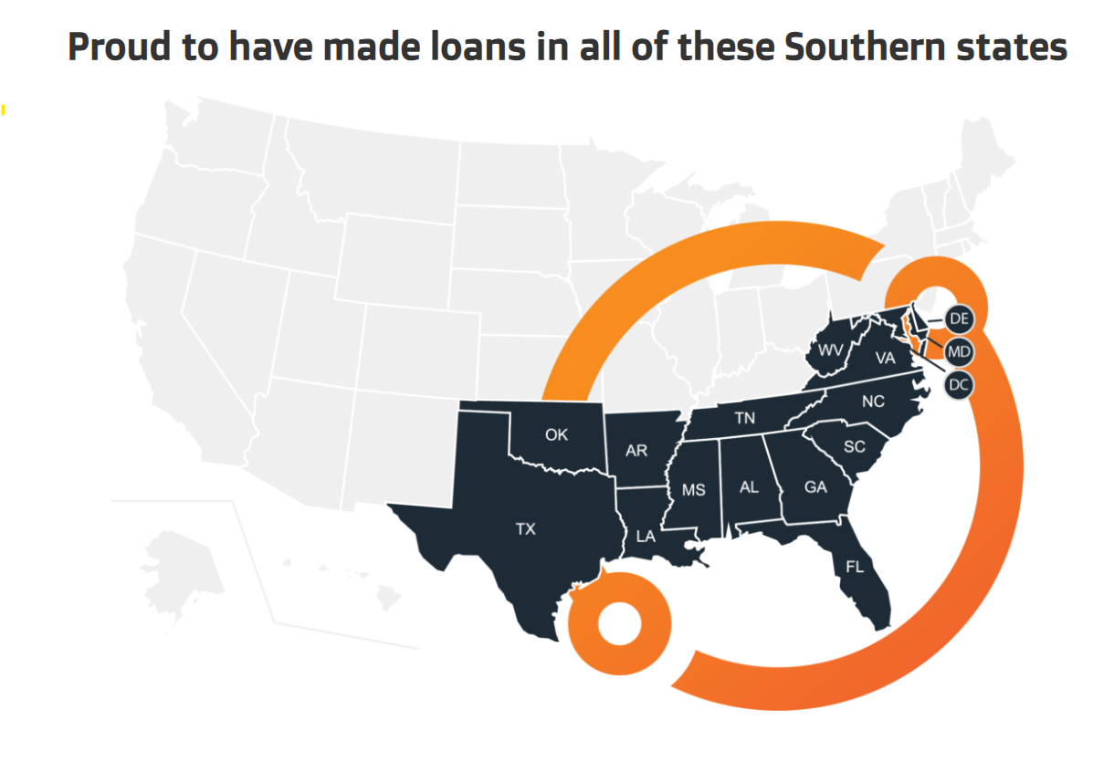
Impact Report
2024

Slide 2
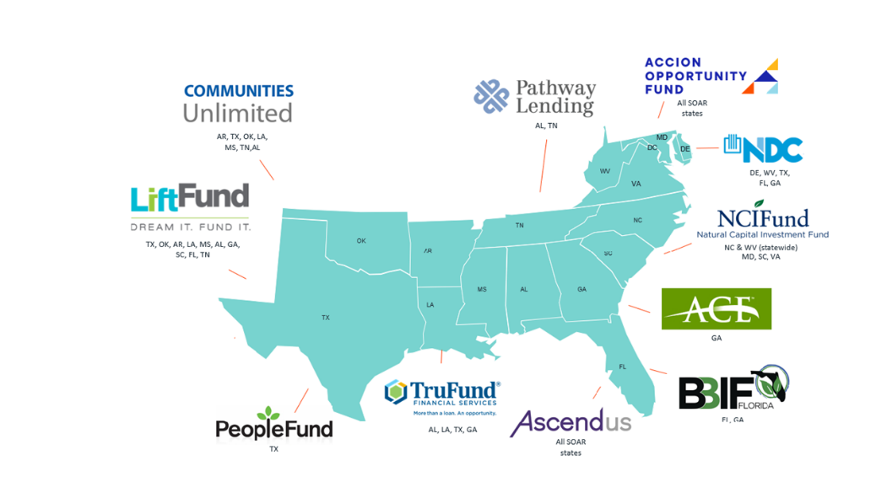
What is SOAR Fund?
Overview
Launched in response to the COVID-19 crisis, the Southern Opportunity and Resilience (SOAR) Fund is a mission-driven conduit loan fund designed to catalyze economic resilience across 15 Southern states by financing small businesses and nonprofits—particularly those historically excluded from traditional lending—as they adapt, reopen safely, and recover from the impacts of the pandemic.
Who manages the fund?
LISC Fund Management (LFM) partners with impact-focused investors—from corporations to philanthropy to government—to maximize capital deployment and drive economic opportunity. Through the SOAR Fund, LFM leveraged investments from 28 partners to establish a loan purchase facility, scaling small business lending across 11 CDFIs. For every $1 of balance sheet capacity, CDFIs were able to originate up to $20 in new small business loans, expanding access to capital where it was needed most.
Our CDFI Partners
11 Participating CDFIs
28 Investors
45 + Partnering Organizations

Slide 3
Community-Centered Lending
By prioritizing borrowers with under $1M in annual revenue and those located in low- and moderate-income (LMI) areas—identified using CRA-eligible census tracts—the SOAR Fund intentionally reached entrepreneurs with the least access to capital during a critical time. In total, 95% of borrowers had revenues under $1M, and 437 loans were issued in LMI areas.
$62.8M
$55K
1,148
Capital Deployed
Average Loan Size
Loans Originated
Small Businesses and Nonprofits
95% to
<$1M revenue
88% have
<10 employees
83% loans made to women-or-minority-led businesses
69% received business coaching

Slide 4
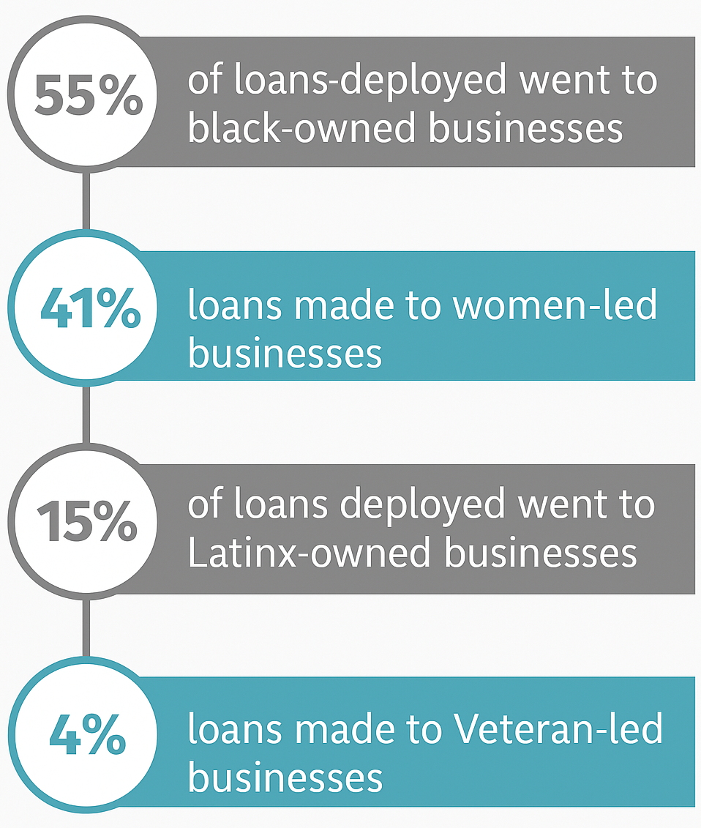
Diversity in Impact
The SOAR Fund delivered over $62M in capital, with 75% of loans reaching minority-led businesses and 83% supporting women or minority-led borrowers. Most recipients were small businesses with fewer than 10 employees and annual revenues under $1M.
Small Businesses | Nonprofits
1,139 loans | 9 loans
$62.1M deployed | $0.7M deployed
4,078 jobs supported | 60 jobs supported

Slide 5
Strength in Collaboration
Eleven mission-aligned CDFIs originated loans, with leading contributors like NDC, Ascendus, and Opportunity Fund extending the majority of capital. This collaboration enabled efficient capital deployment while reinforcing the strength of the local lending ecosystem.

Slide 6
Geographic Footprint
SOAR has supported 1,148 small businesses and nonprofits across 15 states and Washington D.C. totaling $62.8M.
437 loans were disbursed in CRA-eligible communities amounting to $22.5M dollars.
214
For the purposes of this analysis, CRA-eligible census tracts served as a proxy for identifying Low- and Moderate-Income (LMI) areas, based on their alignment with federal CRA criteria.

Slide 7
Industry Diversity
21 industries
The fund played a role in sustaining and growing local employment, backing 4,078 full-time jobs in small businesses and 60 jobs in nonprofits. This job impact underscores SOAR’s role in preserving economic infrastructure and supporting working families.

Slide 8
Real Stories. Real Impact.
“The SOAR loan has been instrumental in helping our company to continue its mission of providing high-quality, personalized pediatric therapy services. It allowed us to stabilize operations during a critical growth phase, invest in our team, and enhance our infrastructure to better serve over 700 children and their families. With this support, we were able to retain key staff, maintain consistent care delivery, and lay the groundwork for long-term expansion and sustainability.”
- Healthcare and Social Assistance, Women-owned business
“The SOAR loan was instrumental in positioning my business for growth and success. Without those funds, I would not have been able to pursue a government contract that has turned out to provide my business with stability in what has become turbulent times, especially after surviving the uncertainty of the global COVID-19 pandemic. I can not say enough about the SOAR loan, and the team that facilitated it. Thank you!!”
- Business Services, Minority-owned / women-owned business
“The SOAR loan we received after the pandemic was truly a lifeline for our business. It played a crucial role in helping us maintain operations and retain our staff during an incredibly difficult time. We are extremely grateful for this support; it made a meaningful difference when we needed it most.”
- Hotels, Minority-owned business

Slide 9
About Local Initiatives Support Corporation & LISC Fund Management
LISC is one of the country’s largest community development organizations, helping forge vibrant, resilient communities across America. LISC works with residents and partners to close systemic gaps in health, wealth and opportunity and advance racial equity so that people and local economies can thrive. Since its founding in 1979, LISC has invested $29.7 billion to create more than 489,261 affordable homes and apartments, developed 81.5 million square feet of retail, community and educational space and help tens of thousands of people find employment and improve their finances.
LISC Fund Management (LFM) is a wholly-owned subsidiary of LISC, and registered investment adviser registered with the U.S. Securities and Exchange Commission (SEC). The private funds sponsored by LISC are available only to eligible investors, are offered only pursuant to their official offering documents, and are managed by LFM. For more, visit www.lisc.org and www.liscstrategicinvestments.org.
Contact
General Information:
soar@lisc.org
liscstrategicinvestments.org/soar-southern-opportunity-and-resilience

Slide 10
Disclaimer
LISC Fund Management, LLC (the “Company”) is registered with the U.S. Securities and Exchange Commission as an investment adviser.
This report is not, and nothing in it should be construed as, an offer, invitation, or recommendation in respect of the Company’s credit facilities or any of the Company’s securities, or an offer, invitation, or recommendation to sell, or a solicitation of an offer to buy, the facilities or any of the Company’s offerings in any jurisdiction. Neither this report nor anything in it shall form the basis of any contract or commitment. This report is not intended to be relied upon as advice to investors or potential investors and does not take into account the investment objectives, financial situation or needs of any investor. All investors should consider such factors in consultation with a professional advisor of their choosing when deciding if an investment is appropriate.
The Company has prepared this report based on information available to it, including information derived from public sources that have not been independently verified. No representation or warranty, express or implied, is provided in relation to the fairness, accuracy, correctness, completeness or reliability of the information, opinions or conclusions expressed herein. No projections should be considered a comprehensive representation of the Company’s cash generation performance. The financial information included in this presentation is preliminary, unaudited, and subject to revision upon completion of the Company's closing and audit processes. This financial information has not been adjusted to reflect the outcome of any reorganization of the company’s capital structure, the resolution or impairment of any pre‐petition obligations, and does not reflect fresh start accounting which the company may be required to adopt.
All forward–looking statements attributable to the Company or persons acting on its behalf apply only as of the date of this document, and are expressly qualified in their entirety by the cautionary statements included elsewhere in this document. Any financial projections are preliminary and subject to change; the Company undertakes no obligation to update or revise these forward-looking statements to reflect events or circumstances that arise after the date made or to reflect the occurrence of unanticipated events. Inevitably, some assumptions will not materialize, and unanticipated events and circumstances may affect the ultimate financial results. Projections are inherently subject to substantial and numerous uncertainties and to a wide variety of significant business, economic and competitive risks, and the assumptions underlying the projections may be inaccurate in any material respect. Therefore, the actual results achieved may vary significantly from the forecasts, and the variations may be material.
There is no assurance that the investment objective of a fund managed by the Company will be achieved or that investors will receive a return on their capital. Investors must read and understand all the risks described in a fund’s final confidential private placement memorandum and/or the related subscription documents before making a commitment. Investors also must consult their own legal, accounting and tax advisors as to the legal, business, tax and related matters concerning the information contained in this document to make an independent determination and consequences of a potential investment in a fund, including US federal, state, local and non-US tax consequences.
Past performance is not indicative of future results or a guarantee of future returns. The performance of any portfolio investments discussed in this document is not necessarily indicative of the performance of any other of the Company’s portfolio investments or any future performance, and investors should not assume that investments in the future will be profitable or will equal the performance of past portfolio investments. Investors should consider the content of this document in conjunction with investment fund quarterly reports, financial statements and other disclosures regarding the valuations and performance of the specific investments discussed herein.
The Company may not be able to achieve its investment objectives (including target returns) for various reasons, as set out in more detail elsewhere in this document and in the offering documents. Among other things, the novel coronavirus (COVID-19) outbreak throughout the world and related responses (e.g., closing of various market segments and businesses) has raised uncertainty in valuing (and making related estimates for) certain assets, including assets that the Company holds or will seek to invest in. This uncertainty could remain for a significant period of time.
Certain information contained herein has been obtained from third-party sources. Although the Company believes the information from such sources to be reliable, the Company makes no representation as to its accuracy or completeness.

